Slide 1
Electric Vehicles vs. Gas Cars: A Comparative Analysis of Environmental Impact
Zicheng (Chance) Xu
MS Data Science, Bellevue University
DSC500: Introduction to Data Science
Professor: Matthew Metzger

Slide 2
Project Overview
Project Goal: Analyze the environmental impact of gas cars (78% of global sales) vs full-electric cars (4.5% of global sales)
Project Process:
Google Trend on people’s interests in car emissions and environmental impact
CO2 life-cycle emission comparison analysis
Raw material production process emission comparison analysis (Excluding CO2)
Manufacturing process emission comparison analysis (Excluding CO2)
Operation process emission comparison analysis (Excluding CO2)
Disposal process emission comparison analysis (Excluding CO2)
Expansional Discussions
Ethical concerns on the shift to the EV market
Challenges and opportunities of the EV market

Slide 3



Google Trend on people’s interests in car emissions and environmental impact
‘electric car environment impact’
‘gas car environmental impact’
‘car emission’

Slide 4
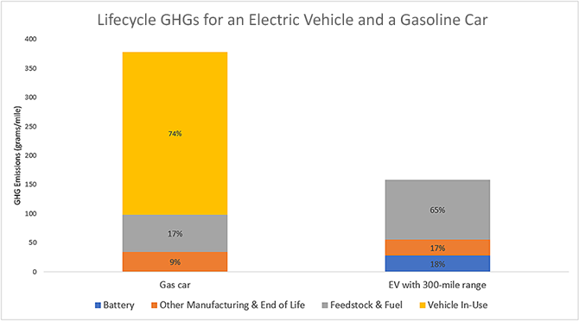
CO2 life-cycle emission comparison analysis
Estimate: The estimated total greenhouse gas emission grams per mile for gas cars is approximately twice that of EVs (factoring in emissions from mineral and metal extractions, etc.)
As the EV sector decarbonizes and improves battery manufacturing efficiency, this disparity is expected to widen

Slide 5
Raw material production process emission comparison analysis
EVs:
Main materials used to battery packs: lithium, cobalt, manganese, nickel, and graphite
Average battery with a 60 kWh capacity: Contains about 52 kg of Graphite, 35 kg of Aluminum, 29 kg of Nickel, 20 kg of Copper, and 20 kg of Steel
Known facts: 99 g emissions excluding CO2 / 1000 g Graphite production; the most carbon-intensive manufacturing process: Steel production; average battery weight: 1000 lbs
Estimation: Assuming Aluminum, Nickel, Copper and Steel produce the same CO per unit of production: 2.6 tons of CO / 1 ton of battery pack production; CO emission: 2,600 lbs / car
Gas Cars:
Main materials used for engines: iron base alloys such as structural steel, stainless steel, iron base sintered metals, and cast iron and aluminum alloy parts for the piston, cylinder head, and cylinder block
Converter gas created from pig iron during the steel production process: about 65% carbon monoxide (CO) and 15% carbon dioxide (CO2)
Known facts: about 1.4 tons of direct direct CO2 emission / 1 ton of steel produced; average engine weight: 350 lbs
Estimation: 6 tons of CO / 1 ton of steel produced; CO emission: 2,100 lbs / car

Slide 6
Manufacturing process emission comparison analysis
Known Facts
Production byproducts: vapors such as volatile organic compounds, resin monomers, and particles, as well as fumes
Harmful effects: short-term: sickness such as irritation and headaches; prolonged contact: damage to the liver, kidneys, and central nervous system; worst case: some volatile organic compounds such as benzene and ethyl benzene can cause cancer
EV productions require 30% to 40% less labor than gasoline cars, as EVs require fewer parts than gas cars.
Conclusion Estimation
EV manufacturing process generates fewer harmful byproducts than the gas car manufacturing process.

Slide 7
Operation process emission comparison analysis
EVs
Assumption: Negligible, as EVs don’t have tailpipes
Gas Cars
Known facts about small gas cars: average of 575 pounds of CO emission / 1 year usage; about 4.43 g harmful byproducts besides CO2 / 1 mile driven; the byproducts include Hydrocarbons, Carbon monoxide (3.9 g), Nitrogen oxides, and particulate matter
Estimation: 78 lbs of Hydrocarbons, Nitrogen oxides, and particulate matter emission / 1 year usage

Slide 8
Disposal process emission comparison analysis
Assumptions/Facts:
Since EVs require fewer parts than gas cars, during the disposal process itself, such as shredding and recycling, although it can generate emissions and pollutants, EVs will emit less
Since vehicle is made out of about 75% metal, most of which will be recyclable, we will compare battery disposal from EVs vs fluids and non-recyclable materials from gas cars
Known estimation of average landfill biogas emission: 150 m^3/103 kg
EVs
Known Facts: average battery weight: 1000 lbs (455 kg)
Estimation: 663 m^3 landfill disposal emission / 1 car; around 1,796 lbs CO / 1 car assuming all are CO
Gas Cars
Known Facts: estimated volume of hazardous fluids in discarded vehicles: 18.7 liters per vehicle at disposal (about 15.84 kg using cooking oil density as an estimated ingredient)
Estimation: 23 m^3 landfill disposal emission / 1 car; around 62 lbs CO / 1 car assuming all are CO

Slide 9
Total estimated life-cycle CO emission
Assumptions/Facts
Both EVs and gas cars have a life of 15 years
EV manufacturing generates fewer harmful emissions during the manufacturing process than gas cars
EVs (manufacturing process not included)
2,600 lbs + 1,796 lbs = 4,396 lbs
Gas Cars (manufacturing process not included)
2,100 lbs + 575 lbs*15 years + 62 lbs = 10,787 lbs

Slide 10
Expansional Discussions
Ethical concerns on the shift to the EV market
Data privacy: EVs gather significant data about driving habits, locations, and charging behaviors; The autonomous driving system of a Tesla allows it to collect up to 19 TBs of data per day from an array of sensors and cameras
Ethical disposal and recycling of batteries
Job losses: Less labor is required
Labor abuse and human rights: Democratic Republic of Congo (DRC) accounts for over 50% of the world’s cobalt reserves; estimation of the 255,000 Congolese mining for cobalt: 40,000 are children, with some as young as six years
Challenges and opportunities of the EV market
Opportunities: > 20% annual EV market growth rate; New Zealand startup CarbonScape: can turn 7 tons of dry wood chips (compared to fossil fuels) into a form of synthetic graphite at 1 ton in hours (compared to weeks) and significantly reduces harmful byproducts emission; Chinese EV Maker NIO offers battery swap technology which take 3 minutes
Challenges: Average time spent as gas station: 8 minutes vs 30 min using rapid charger for 241 miles range; Typical home charging points: take 11 - 21 hours

